Slide 1
System Testing ( cont.)
Course Code: CSC4133
Course Title: Software Quality and Testing
Dept. of Computer Science
Faculty of Science and Technology
Lecturer No: | 21 | Week No: | 12 | Semester:
Lecturer: | Name & email

Slide 2
Lecture Outline
Basic Idea
Modeling Defects
Preparedness to Start System Testing
Metrics for Tracking System Test
Metrics for Monitoring Test execution
Metrics for Monitoring Defect Reports
Orthogonal Defect Classification
Defect Causal Analysis
Beta Testing
System Test Report
Measuring Test Effectiveness

Slide 3
Objectives and Outcomes
Objectives: To understand the basic concept of beta testing, to understand system test report, to understand measuring test effectiveness techniques.
Outcomes: Students are expected to be able to explain beta testing, be able to explain how to generate system test report, be able to explain three techniques of measuring test effectiveness.

Slide 4
Beta Testing
Beta testing is conducted by the potential buyers prior to the official release of the product.
The purpose of beta testing is not to find defects, but to obtain feedback from the field about the usability of the product.
A decision about when to release the system to the beta customers is made by the software project team members. The beta release criteria are established by the project team.
A framework for writing beta release criteria is given in Table 13.13
The system test cycle continues concurrently with beta testing
Weekly meetings are conducted with the beta customers by the beta support team to resolve issues.

Slide 5
Beta Testing Categories
Beta testing can be three categories:
Marketing beta: Beta testing that builds early awareness and interest in the product among potential buyers.
Technical beta: Testing conducted to obtain feedback about the usability of the product in a real environment with different configurations from a small # of friendly customers.
Acceptance beta: Testing conducted to ensure that the product meets its acceptance criteria.

Slide 6
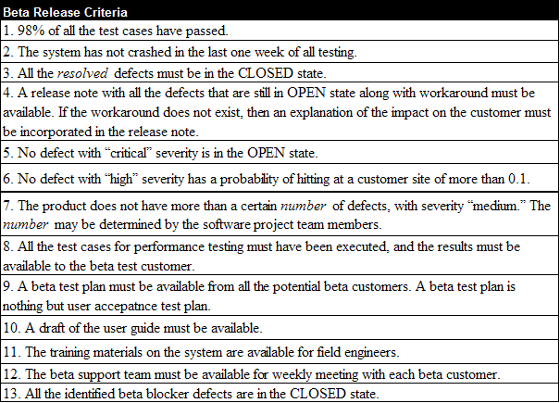
Beta Release Criteria: Example
Table 13.13: A framework for beta release criteria

Slide 7
First Customer Shipment (FCS)
A set of generic FCS readiness criteria is as follows:
All the test cases from the test suite should have been executed
Test case results are updated with Passed, Failed, Blocked, or Invalid status
The requirements are updated by moving each requirement from the Verification state to either the Closed or the Decline state
The pass rate of test cases is very high, say, 98%
No crash in the past two weeks of testing has been observed

Slide 8
First Customer Shipment (FCS)
A set of generic FCS readiness criteria (cont.)
No known defect with CRITICAL or HIGH severity exists in the product
Not more than a certain number of known defects with MEDIUM and LOW levels of severity exist in the product
All the resolved defects must be in the CLOSED state
The User Guides are in place
Trouble Shooting Guide is available
The Test Report is completed and approved

Slide 9
System Test Report
During the test execution cycles test reports are generated and distributed. A final summary report is created after completion of all the test cycles. The structure of a typical final report is outlined in the next slide.
System Test Report must be generated before the product’s general availability (GA) is declared.

Slide 10
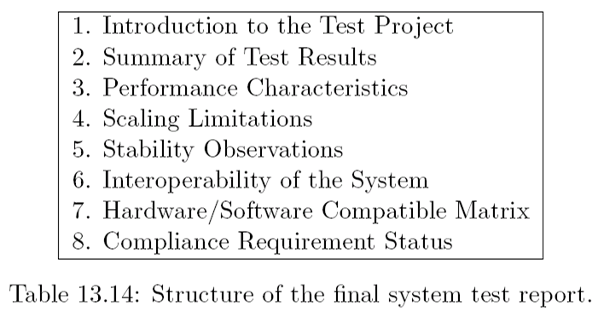
System Test Report

Slide 11
Product Sustaining
Once the product is shipped to one of the paying customers, the software project is moved to sustaining phase.
The goal of this phase is to maintain the software quality throughout the product’s market life.
Software maintenance activities occur because software testing cannot uncover all the defects in a large software system.

Slide 12
Product Sustaining
The following three software maintenance activities were coined by Swanson:
Corrective: The process that includes isolation and correction of one or more defects in the software
Adaptive: The process that modifies the software to properly interface with a changing environment such as new version of hardware or third party software
Perfective: The process that improves the software by the addition of new functionalities, enhancements, and/or modifications to the existing functions

Slide 13
Measuring Test Effectiveness
It is useful to evaluate the effectiveness of the testing effort in the development of a product.
After a product is deployed in the customer environment, a common measure of test effectiveness is the # of defects found by the customers that were not found by the test engineers prior to the release of the product.
The objective of a test effectiveness metric is to evaluate the effectiveness of a system testing effort in the development of a product in terms of the number of defects escaped from the system testing effort.

Slide 14
Measuring Test Effectiveness
Metrics to measure test effectiveness:
Defect removal efficiency (DRE)
Defect Age
Spoilage

Slide 15
Defect Removal Efficiency (DRE)
A metric commonly used in the industry to measure test effectiveness is the defect removal efficiency (DRE).
DRE is the ratio of the # of defects discovered in an activity to the # of defects that should have been found.
Defect Removal Efficiency (DRE) is defined as follows:

Slide 16
Defect Removal Efficiency (DRE)
We obtain the “number of defects found in testing” from the defect tracking system. BUT how to get the “number of defects not found “?
Calculating the number of defects not found during testing is a difficult task. One way to approximate this number is to count the defects found by the customers within the first six months of its operation. Several issues need to consider.
Defects submitted by customers that need corrective maintenance are taken into consideration in this measurement. Defects submitted that need either adaptive or perfective maintenance are not real issues in the software.
Fault seeding approach can be used to estimate the # of escaped defects.

Slide 17
Fault Seeding
Fault seeding is a process of intentionally adding known faults in a computer program for the purpose of monitoring the rate of detection and removal of faults and estimating the number of faults remaining in the program.
− Fault seeding approach is used to estimate the # of escaped defects
− Inject a small number of defects into system
− Measure the percentage of defects that are uncovered by the test engineers
− Estimate the number of actual defects using an extrapolation technique

Slide 18
Fault Seeding

Slide 19
Defect Age
An useful measure of test effectiveness is Defect age, called PhAge.
Defect Age is a metric that can be used to measure the test effectiveness which assigns a numerical value to the fault depending on the phase in which it is discovered.
The later we discover a bug, the greater harm it does, and the more it costs to fix.
For example, a requirement defect discovered during a high-level design review would be assigned a PhAge of 1. If this defect had not been found until system testing, it would have been assigned a PhAge of 6.

Slide 20
Spoilage Metric
Defects are injected and removed at different phases of a software development cycle.
The cost of each defect injected in phase X and removed in phase Y increases with the increase in the distance between X and Y.
An effective testing method would find defects earlier than a less effective testing method would.
Defect spoilage is a metric that uses Phase Age and distribution of defects to measure the effectiveness of defect removal activities.

Slide 21
Defect Spoilage Metric

Slide 22
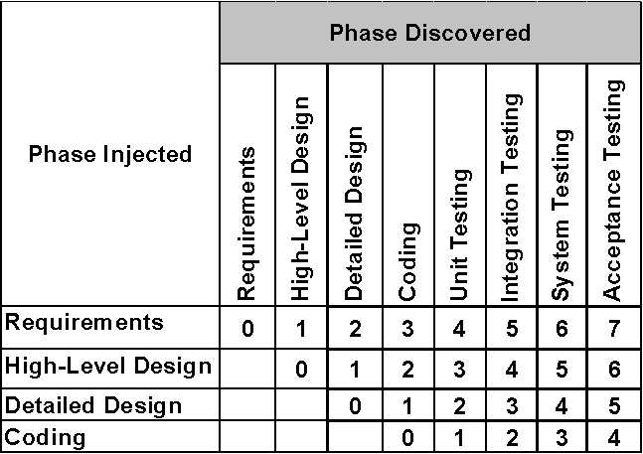
Table 13.15: Scale for defect age

Slide 23
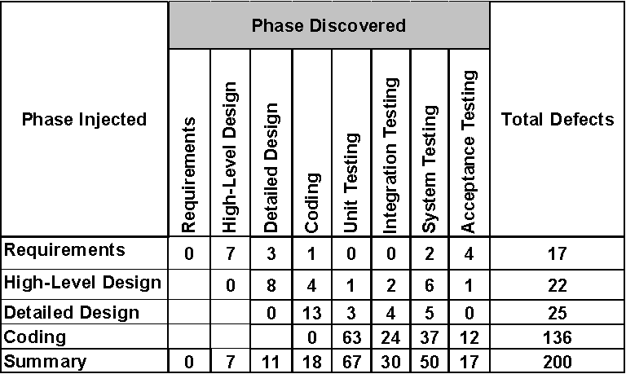
Spoilage Metric
Table 13.16: Defect injection and versus discovery on project Boomerang

Slide 24
Spoilage Metric
The spoilage value for the Boomerang test project is 2.2
A spoilage value close to 1 is an indication of a more effective defect discovery process
As an absolute value, the spoilage metric has little meaning
This metric is useful in measuring the long-term trend of test effectiveness in an organization
This metric is useful in measuring the long-term trend of test effectiveness in an organization.

Slide 25
Books
Software Testing and Quality Assurance: Theory and Practice, by Kshirasagar Naik, Priyadarshi Tripathy

Slide 26
References
Software Quality Assurance: From Theory to Implementation, by Daniel Galin
The Art of Software Testing, by Glenford J. Myers, Corey Sandler and Tom Badgett

